Slide 1
Project Overview

Slide 2
Hello !
We are GROUP 16
Github: https://github.com/chalovina/Group16/tree/master/Group16_MppProject
Demo Video: https://www.youtube.com/watch?v=DoL4I_s_dPo

Slide 3
All features are implemented (including extra optional parts)
Login
Checkout
Add copy
Add library member
Add book
Search and print checkout entry record
Search and print overdue checkout

Slide 4
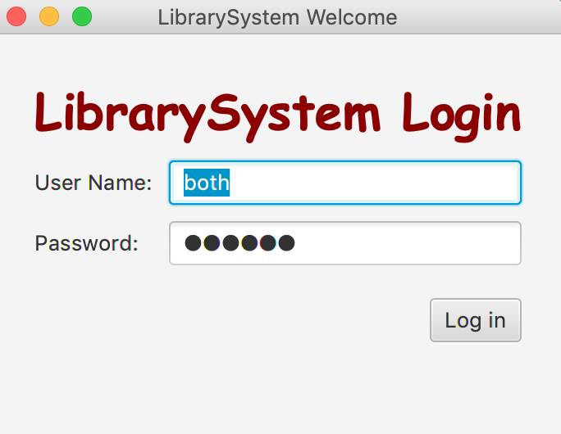
1.LOGIN
Difference roles: Super Admin: both
Admin: admin
Librarian: lib

Slide 5
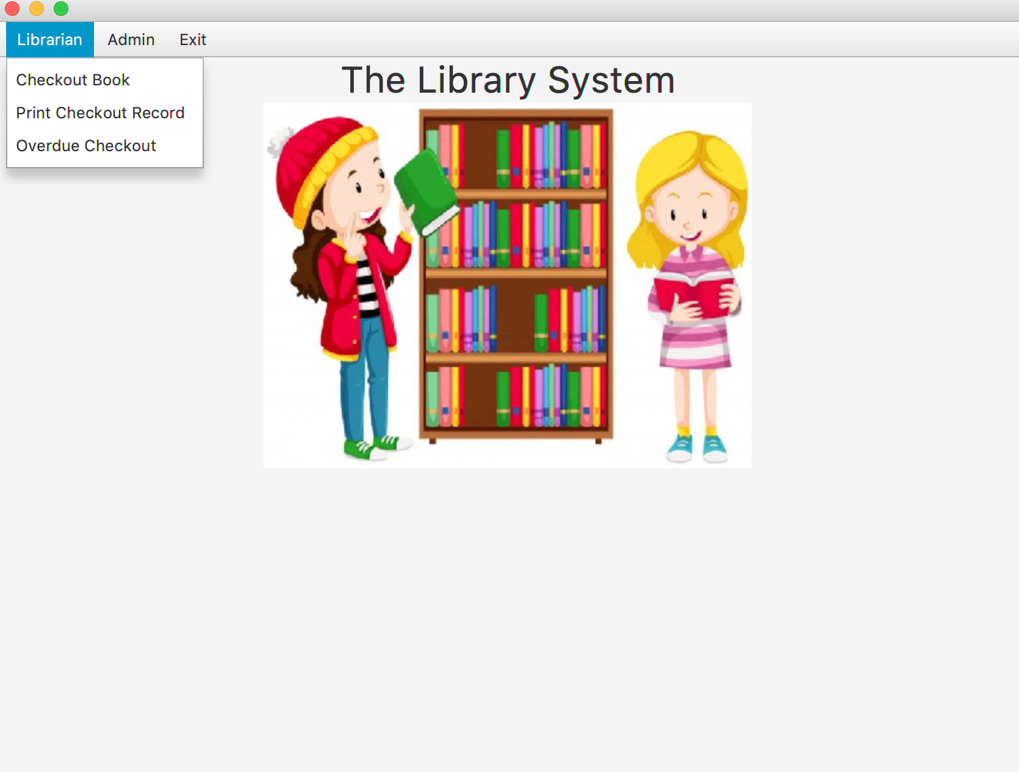
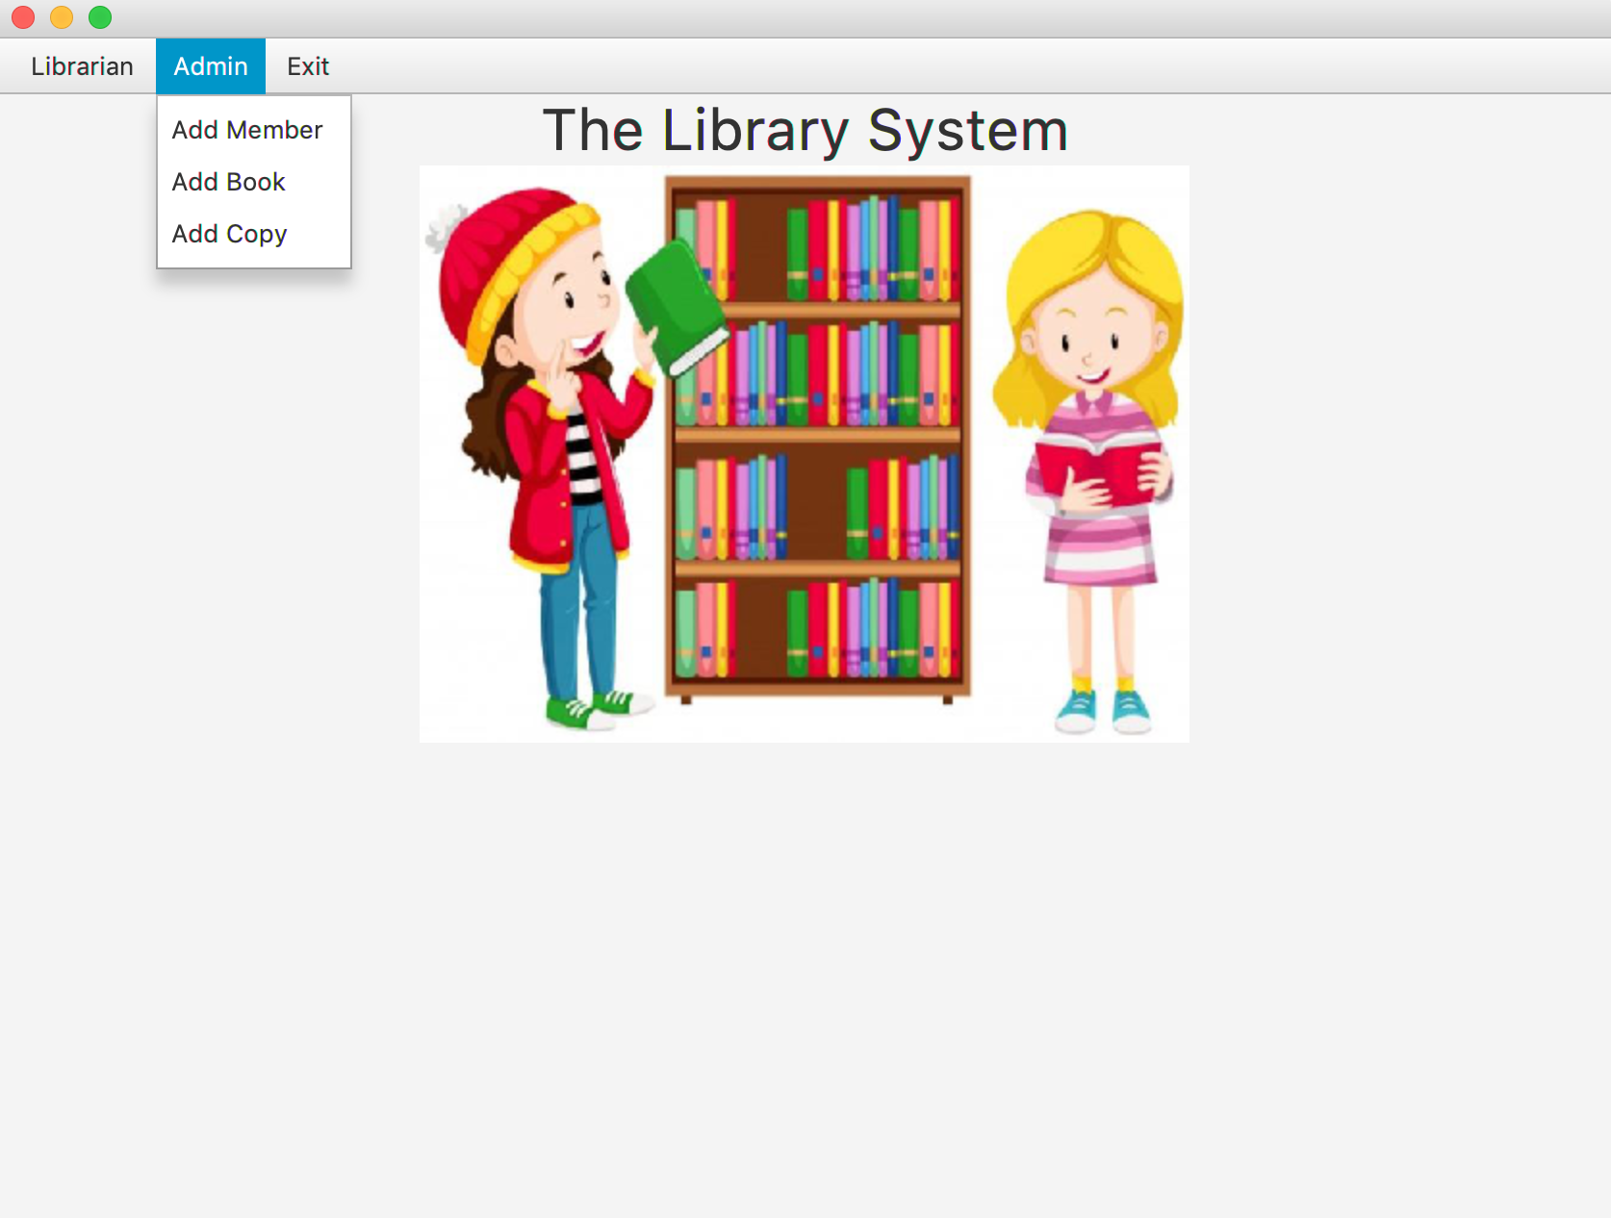
Super admin view
Super admin has fully permission for role: Admin and Librarian

Slide 6
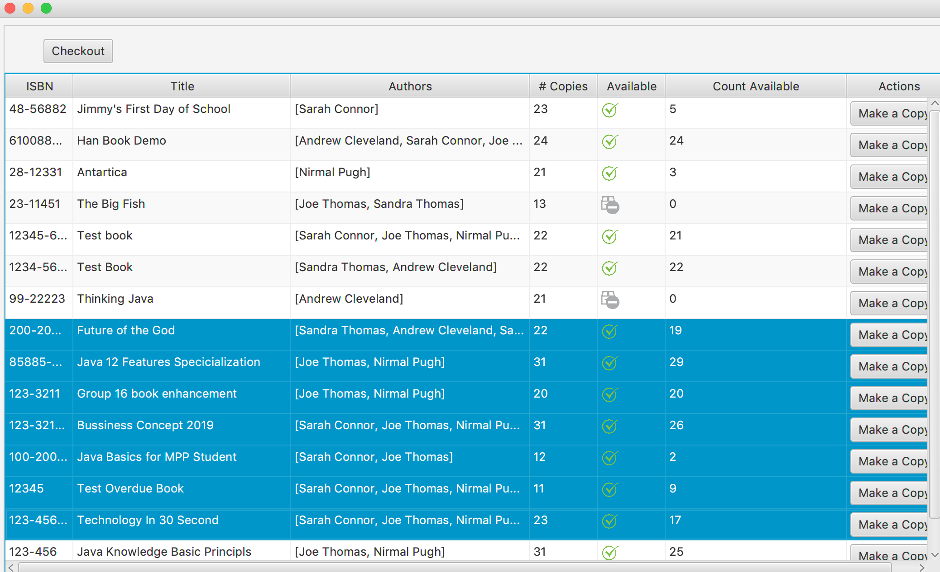
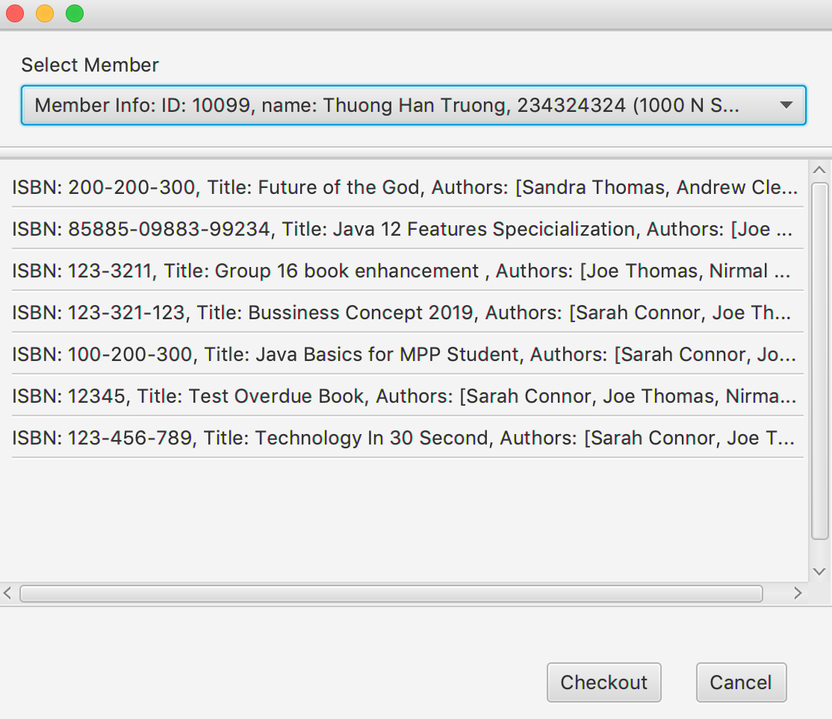
Checkout, Make a copy and more

Slide 7
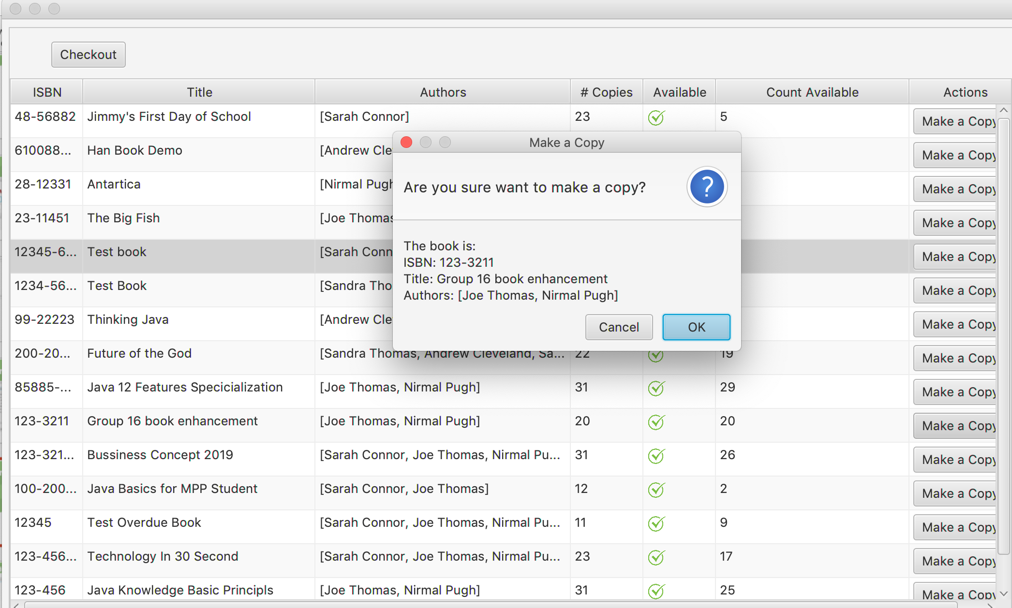
Checkout, Make a copy and more

Slide 8
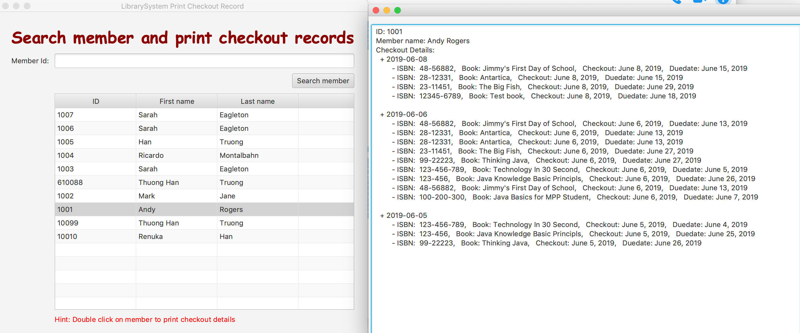
Search member and print checkout records

Slide 9
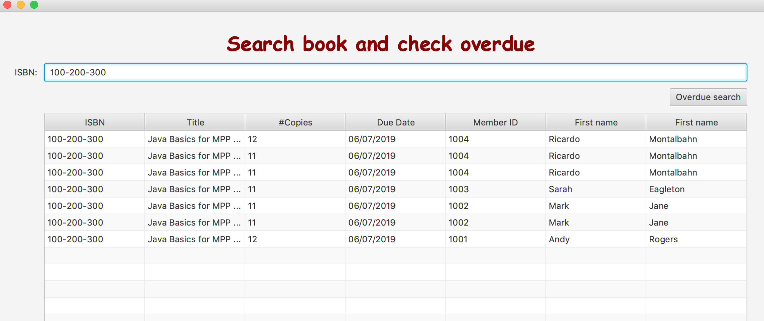
Search member for overdue

Slide 10
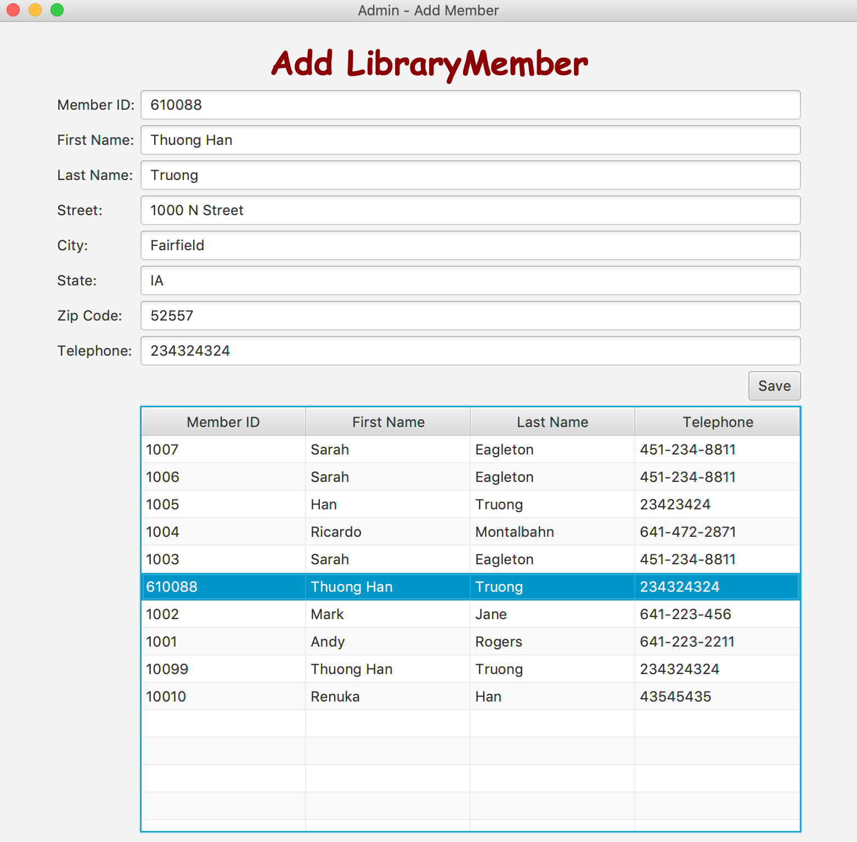
Add library member

Slide 11
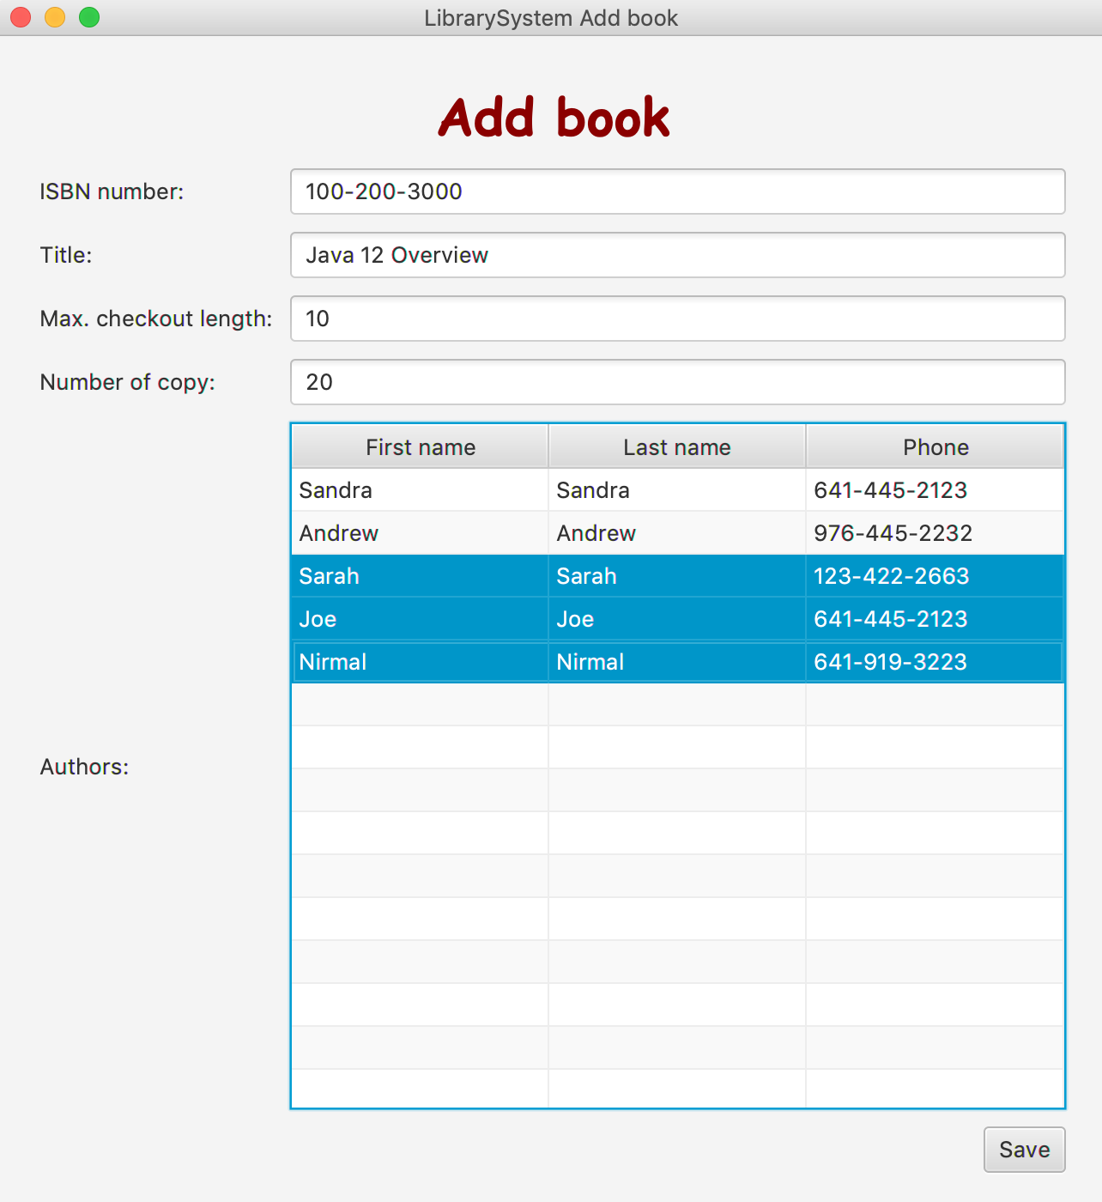
Add book

